Slide 1


Barack & Michelle Obama Academy
GO TEAM MEETING
Wednesday, October 19, 2022 @ 4:45 pm

Slide 2
Meeting Agenda
(agenda may be amended)
This meeting will not allow for Public Comment
I
CIP-45 Day Check-in
School Strategic Plan
Discussion on Strategic Plan and progress
Updates for Strategic Plan (as necessary)

Slide 3
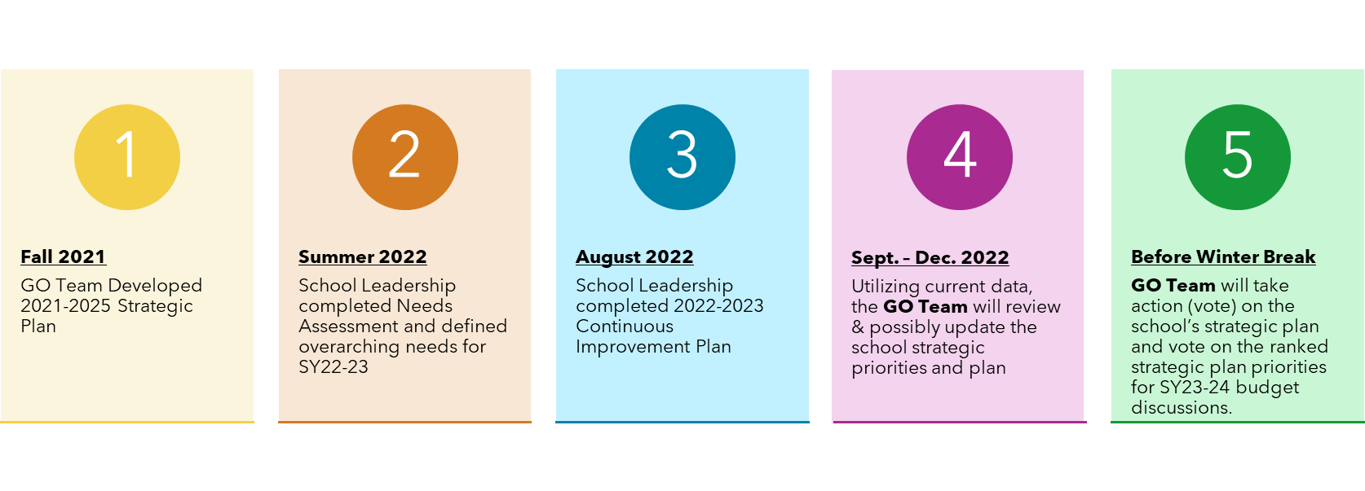
Timeline for GO Teams

Slide 4
I
Quarterly CIP Check In
As part of the Continuous Improvement process, all APS schools are completing a quarterly check-in for the Continuous Improvement Plans.
Questions to Consider
•Based on our year long CIP plan, what are the actions that the school has already completed?​
•What data supports the completion of an action step and success criteria (both implementation and student achievement)?

Slide 5
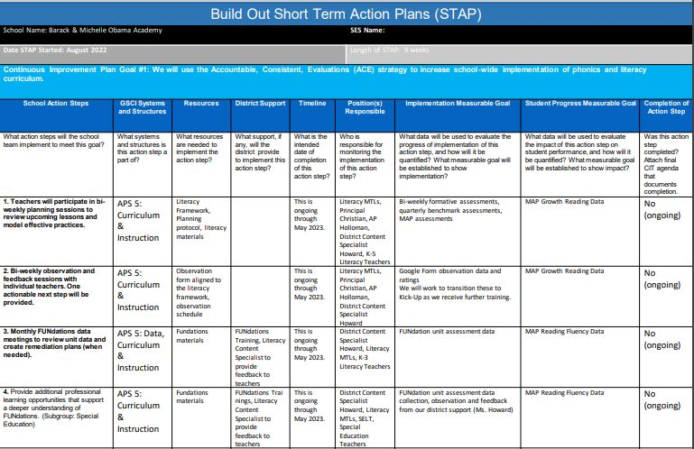
Notes:
https://apsstudents.sharepoint.com/:p:/r/teams/ContinuousImprovementPlan/_layouts/15/doc2.aspx?sourcedoc=%7B84A1744E-C627-4FA5-9D76-EE1547AD2027%7D&file=BAMO%202022%20Continuous%20Improvement%20Plan.pptx&action=edit&mobileredirect=true&DefaultItemOpen=1&ct=1665580654283&wdOrigin=OFFICECOM-WEB.MAIN.EDGEWORTH&cid=89110a6a-beb8-46b6-88ac-522705955bed

Slide 6
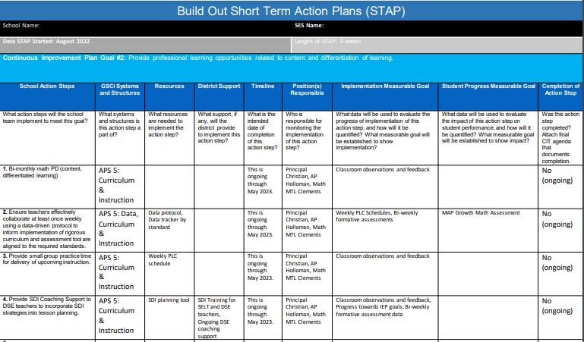
Notes:
https://apsstudents.sharepoint.com/:p:/r/teams/ContinuousImprovementPlan/_layouts/15/doc2.aspx?sourcedoc=%7B84A1744E-C627-4FA5-9D76-EE1547AD2027%7D&file=BAMO%202022%20Continuous%20Improvement%20Plan.pptx&action=edit&mobileredirect=true&DefaultItemOpen=1&ct=1665580654283&wdOrigin=OFFICECOM-WEB.MAIN.EDGEWORTH&cid=89110a6a-beb8-46b6-88ac-522705955bed

Slide 7
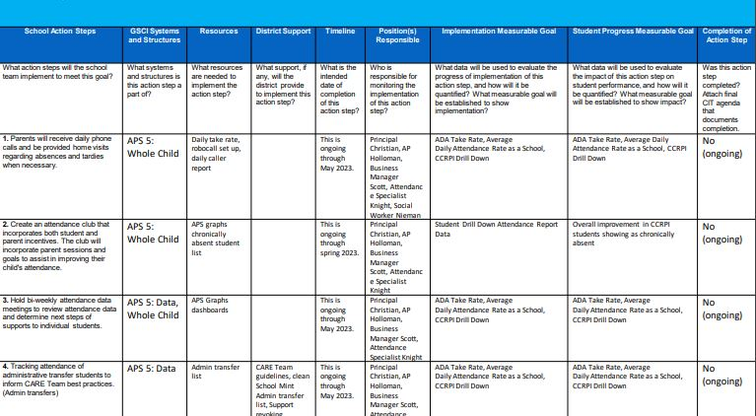
Notes:
https://apsstudents.sharepoint.com/:p:/r/teams/ContinuousImprovementPlan/_layouts/15/doc2.aspx?sourcedoc=%7B84A1744E-C627-4FA5-9D76-EE1547AD2027%7D&file=BAMO%202022%20Continuous%20Improvement%20Plan.pptx&action=edit&mobileredirect=true&DefaultItemOpen=1&ct=1665580654283&wdOrigin=OFFICECOM-WEB.MAIN.EDGEWORTH&cid=89110a6a-beb8-46b6-88ac-522705955bed

Slide 8
STRATEGIC PLAN
PROGRESS

Slide 9
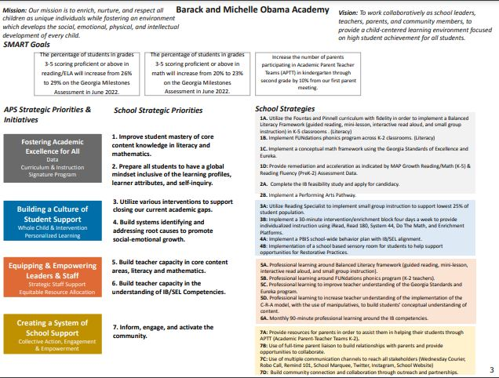
Our Strategic Plan
Notes:
https://www.atlantapublicschools.us/cms/lib/GA01000924/Centricity/Domain/11671/School%20Strategic%20Plan%20Workbook%20and%20Template_BAMO_Updated%201.12.21.pdf

Slide 10
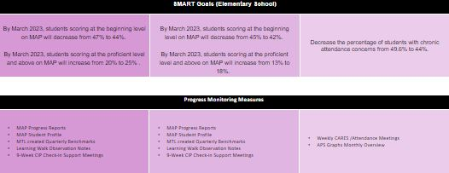
Updates to the Strategic Plan

Slide 11
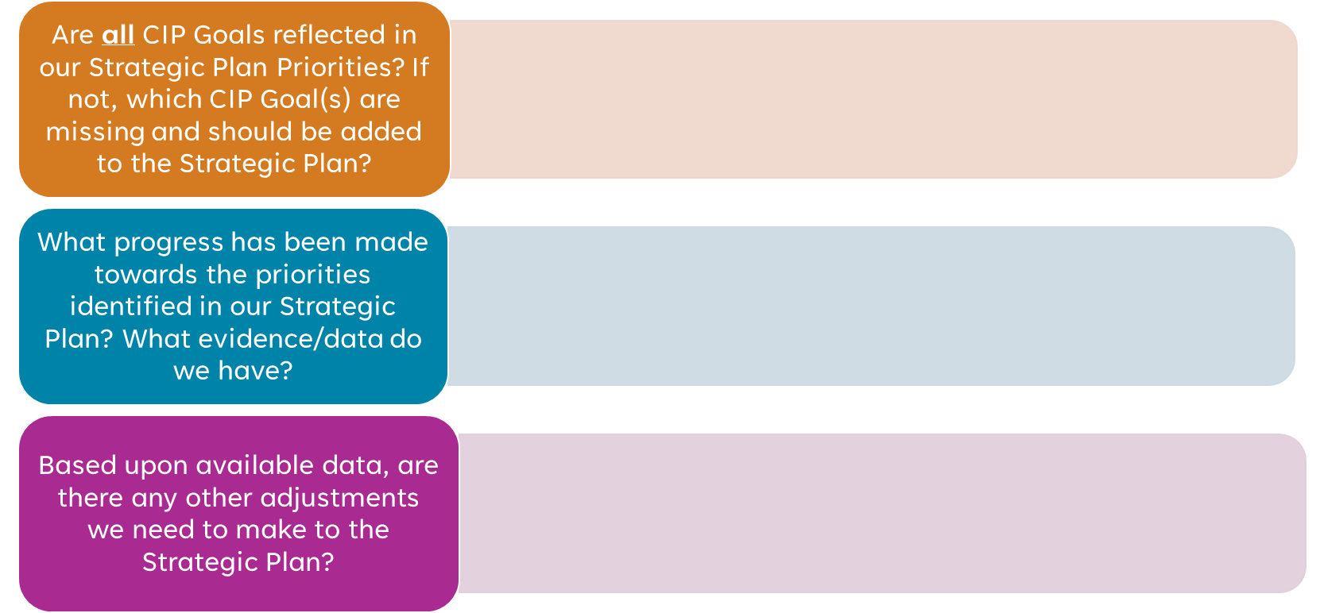
Activity & Discussion
Review the priorities and goals in your strategic plan and reflect on if the expected progress is being made. These guiding questions will help you determine what, if any, updates are needed for your school’s strategic plan.

Slide 12

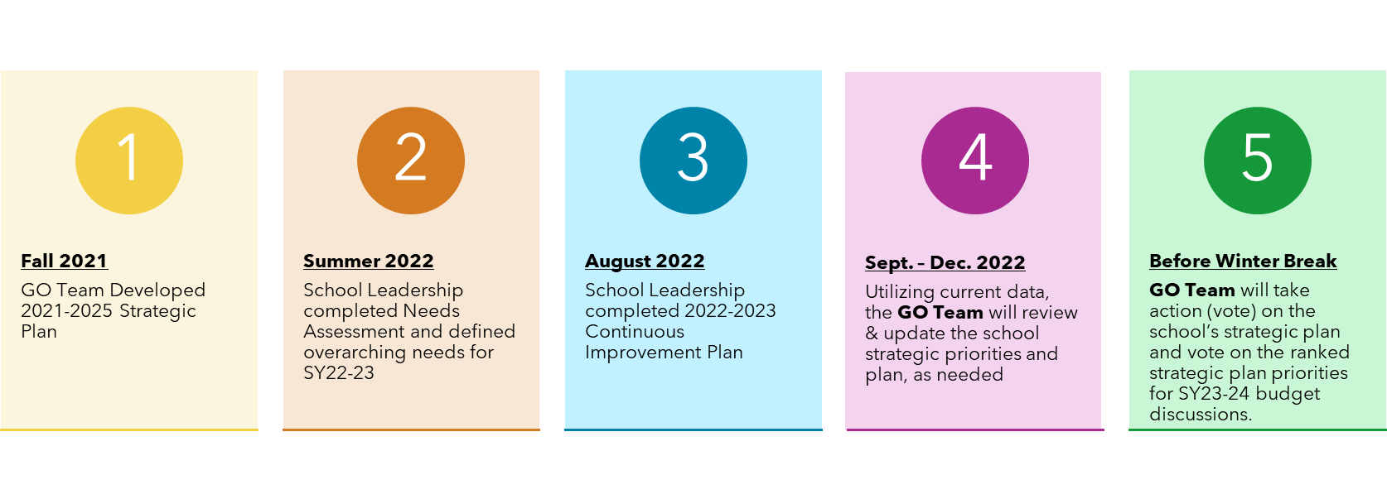
Be prepared for our next meeting:
At our NEXT meeting

Slide 13
PRINCIPAL’S REPORT

Slide 14
INSTRUCTIONAL UPDATE

Slide 15
BUDGET UPDATE

Slide 16
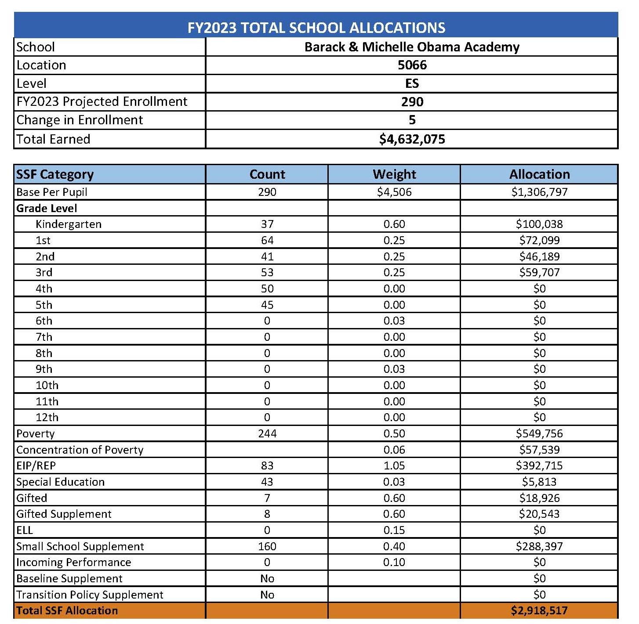
FY23
ALLOCATION

Slide 17
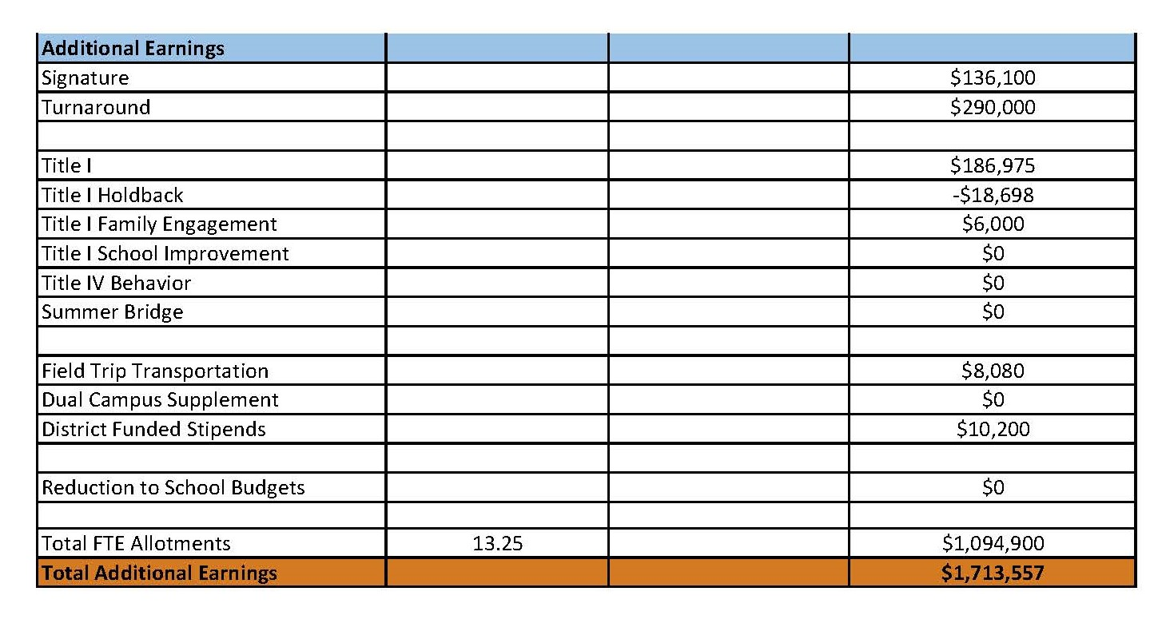
I
FY23
ALLOCATION

Slide 18

Priorities | APS FIVE Focus Area | Strategies | Requests | Amount
Improve student mastery of core content knowledge in literacy and mathematics . | Curriculum & Instruction, Whole Child & Intervention | Provide remediation and acceleration as indicated by MAP Growth Reading/Math (K-5) Reading Fluency (PreK-2)Assessment Data. | Add a Turnaround Math Specialist | $105, 151
Prepare students to have a global mindset inclusive of the learner attributes, and self inquiry. | Signature Programming | Support the Implementation of the IB programming. | Add a Signature IB Specialist | $106, 578
FY23 Strategic Plan Break-out

Slide 19
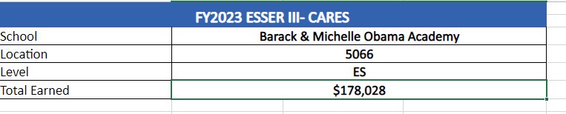

Slide 20
Plan for FY23 CARES Allocation
Priorities | APS Five Focus Area | Strategies | Requests | Amount
Improve student mastery of core content knowledge in literacy and mathematics. | Fostering Academic Excellence for All | Provide Remediation and acceleration as indicated by MAP Growth Reading/Math K-5 & Reading Fluency . | (3) Paraprofessionals at Grades 3-5 (1.0 FTE) | $131, 096
Build systems identifying and addressing root causes to promote social-emotional growth. | Building a Culture of Student Support | Implement a PBIS school wide behavior plan with IB/SEL Alignment | Full Time Counselor (.5 FTE) | $41,925
Build systems identifying and addressing root causes to promote social-emotional growth. | Building a Culture of Student Support | Implement a PBIS school wide behavior plan with IB/SEL Alignment | Student Incentives | $5410

Slide 21
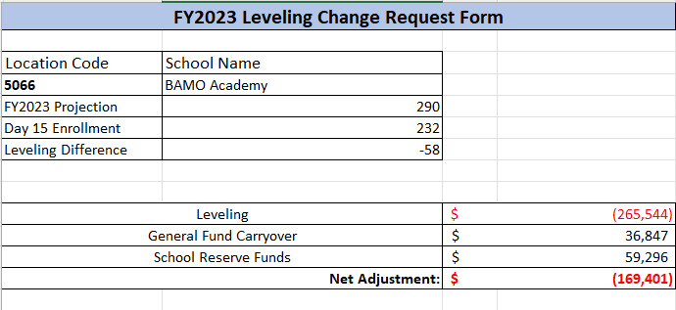
Leveling Change

Slide 22
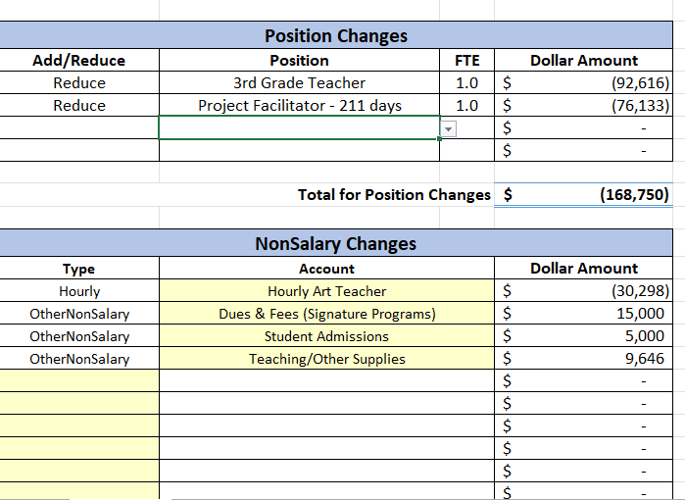
Leveling Change

Slide 23
Priorities | APS Five Focus Area | Strategies | Requests | Amount
Inform, engage, and activate the community. | Creating a System of School Support | Use of a full time Parent Liaison to build relationships with parents and provide opportunities to collaborate | Switch from an Hourly Parent Liaison to a Full Time Parent Liaison. | $26, 755
Build Teacher Capacities in the Understanding of IB/SEL Competencies. | Whole Child & Intervention, Signature Programming | Professional Learning around IB/SEL | Provide IB implementation training for staff | $10, 000
Prepare all students to have a global mindset inclusive of the learning profiles, learner attributes, and self inquiry. | Fostering Academic Excellence for All | Implement a Performing Arts Pathway | Add Hourly Dance Teacher | $21, 615
FY23 Plan for Leveling Reserve
PENDING

Slide 24
FY23 Plan for Title I
Holdback
Priorities | APS Five Focus Area | Strategies | Requests | Amount
Utilize Various interventions to support closing our current academic gaps. | Building a Culture of Student Support | Implement a 30 minute intervention intervention/enrichment block 4 days a week to provide individualized instruction | Add Teacher Tutors | $18,698

Slide 25




